Slide 1
IoT Security Lifecycle
Module - 1
Dr. Ganesh Khekare, SCOPE, VIT
1

Slide 2
The IoT Security Lifecycle
The security engineer's job is to define an appropriate lifecycle focused on maintaining a secure state across the enterprise.
The lifecycle is designed to be iterative, allowing for the secure addition of new IoT capabilities throughout an enterprise.
An IoT security lifecycle should support an enterprise IoT ecosystem with the following:
  Privacy considerations due to the potential to leak sensitive information.
  new devices must be configured securely.
  Autonomous operations and device-to-device transactions that worsen the impact of an intrusion.
Dr. Ganesh Khekare, SCOPE, VIT
Privacy & Security in IoT
2

Slide 3
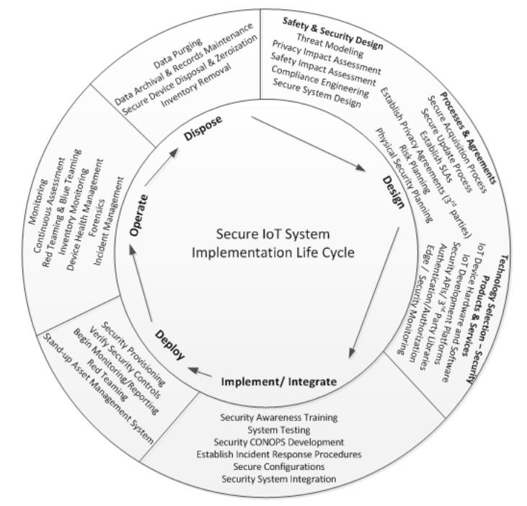
Dr. Ganesh Khekare, SCOPE, VIT
3

Slide 4
Implementation and integration
End-user organizations will have many options for deploying functional IoT capabilities.
  Some organizations will develop IoT systems themselves.
  many options will exist for the procurement of pre-packaged IoT systems.
Example: Beyond Line of Sight (BLOS) Unmanned Aircraft Systems (UAS) operations in the United States.
The first step in the security lifecycle is to create a security concept of operations (CONOPS) document reflecting the given system, its security needs, and how to satisfy them
4

Slide 5
Implementation and integration (Contd.,)
IoT security CONOPS document:
Tool for methodically detailing the security operations of the IoT system.
The document should be written and maintained by IoT system operators to provide a roadmap for system implementers during implementation and integration.
An IoT security CONOPS document should contain material covering, at a minimum of the following,
5

Slide 6
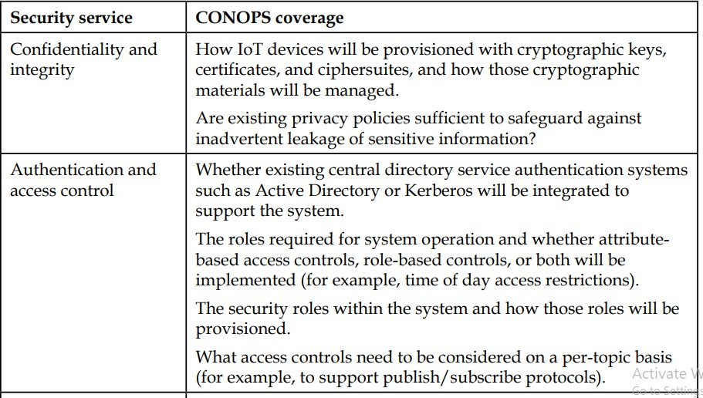
Implementation and integration (Contd.,)
Example of CONOPS
6

Slide 7
Implementation and integration (Contd.,)
Network and security integration:
Examining network and security integration for WSNs
  WSN, includes sensors that probably communicate using a RF-based protocol such as ZigBee.
  These devices may communicate at the application layer using tailored IoT protocols such as MQTT-SN.
  Gateways provide the ability to deploy IoT devices without IP connectivity back to the cloud.
  Leverage the capabilities of a protocol such as TLS between the MQTT gateway and backend services.
7

Slide 8
Implementation and integration (Contd.,)
Network and security integration:
Examining network and security integration for connected cars,
  Connected vehicles communicate using the DSRC protocol.
  Messages are secured using the inherent capabilities of the DSRC protocol, which include the ability to provide data origin authentication.
  No matter the type of IoT deployment, these systems need to be configured to
communicate with an organization's existing technology infrastructure.
  Engineers should spend considerable time planning these integration activities.
8

Slide 9
Implementation and integration (Contd.,)
Planning for updates to existing network and security infrastructures:
Lifecycle activity involves the integration planning needed to incorporate new IoT services into existing infrastructures.
In situations where IoT systems must process and act upon data in near real time, it is necessary to re-evaluate the move toward centralized data processing.
Cisco Systems, Fog Computing to address the need to shift to a more decentralized model.
The Fog Computing model places compute, storage, and application services at the network edge
9

Slide 10
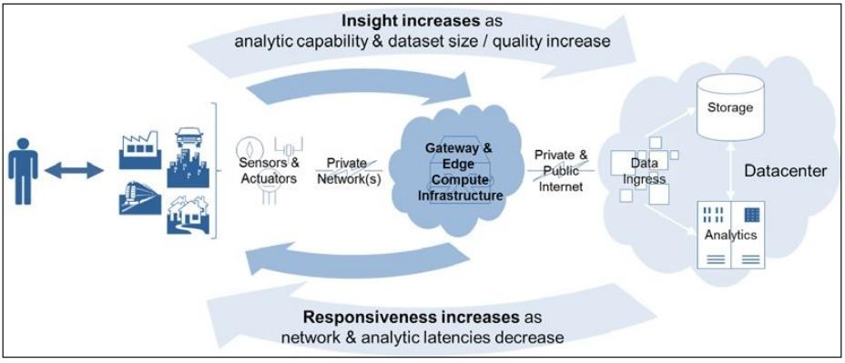
Dr. Ganesh Khekare, SCOPE, VIT
10

Slide 11
Implementation and integration (Contd.,)
Planning for provisioning mechanisms:
Engineers must also plan to provision network information required for the IoT devices and gateways to operate properly.
WSNs that use communication protocols such as Bluetooth, ZigBee, and ZWave do not require the provisioning of an IP address.
Organizations choosing to provision devices with IPv6 addresses face additional security engineering tasks.
Organizations must also plan for any required domain name system (DNS) integration.

Slide 12
Implementation and integration (Contd.,)
Integrating with security systems:
IoT systems will also need to be integrated with existing enterprise security systems.
Interfaces to these systems would have been created during development of the IoT system.
Examples of enterprise security systems that an IoT deployment will likely integrate with,
  Directory systems
  Identity and access management (IAM) systems
  Security information and event management (SIEM) systems
  Wireless access control systems
IoT and data buses

Slide 13
Implementation and integration (Contd.,)
System security verification and validation (V&V):
This testing will occur throughout the development lifecycle as well as the implementation/integration, deployment, and operations ones.
Verification provides the assurances that the system operates according to a set of requirements that appropriately meet stakeholder needs.
Validation is the assurance that an IoT system product, service, or system meets the needs of the customer and other identified stakeholders—in an IoT system.
One approach to verifying functional security requirements is to create test drivers or emulators that exercise functionality.

Slide 14
Implementation and integration (Contd.,)
Security training:
The 2015 OpenDNS in the Enterprise report provided an early glimpse into challenges that security practitioners will soon face.
The creation of security training requires periodic review and the possible creation of new security policies needed to support different IoT paradigms.
These policies should be used as source material for both end-user security awareness training as well as security administration training.
Security awareness training for users
Security administration training

Slide 15
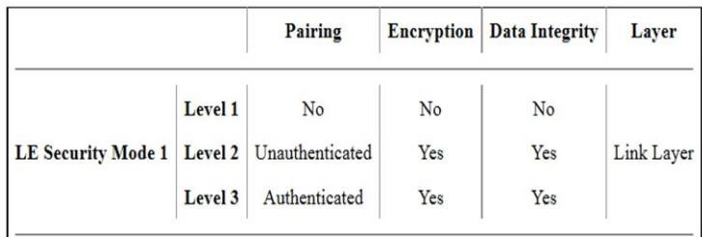
Implementation and integration (Contd.,)
Secure configurations:
IoT systems involve many diverse components and each must be configured in a secure manner.
Each component must also be configured to interface with other components securely.
IoT device configurations (eg: lock the open ports)
Secure gateway and network configurations.

Slide 16
Operations and maintenance
The secure operations and maintenance of IoT systems supports activities such as managing credentials, roles and keys.
Managing identities, roles, and attributes:
In addition to naming, establish clear registration processes.
Registration processes should be broken into tiers based on the sensitivity of the data handled by the devices.
Identity relationship management and context
Attribute-based access control
Role-based access control
Consider third-party data requirements
Manage keys and certificates

Slide 17
Operations and maintenance(Contd.,)
Security monitoring:
Operation of IoT systems requires that assets be sufficiently monitored for abnormal behavior to mitigate potential security incidents.
Using traditional SIEM systems alone insufficient.
Data analytics to IoT-based messaging identifies anomalies within operation of an IoT system quickly, even when device audit logs are not readily available.

Slide 18
Operations and maintenance(Contd.,)
Penetration testing:
Regularly scheduled penetration test activities as well as autonomous tests that occur throughout the cycle of operation.
Penetration tests can also validate the existing security controls and identify gaps within the implemented security controls.
Red and blue teams
Evaluating hardware security
The airwaves
IoT penetration test tools (eg: BlueMaho, Bluelog, crackle, SecBee, etc.,)

Slide 19
Operations and maintenance(Contd.,)
Compliance monitoring:
The Center for Internet Security (CIS) released an addendum to the 20 Critical Controls that details coverage of each control within the IoT.
Asset and configuration management:
By incorporating new data analytics techniques into an IoT ecosystem, organizations can benefit from these new capabilities and apply them to the IoT assets themselves.
Automatically respond to failures and even autonomously swap out broken components for new replacements.

Slide 20
Operations and maintenance(Contd.,)
Incident management:
Managing IoT-related incidents requires that security staff have better insights into how the compromise or disruption of a particular IoT system impacts the business.
Forensics:
The IoT opens up new data-rich opportunities to facilitate forensics processes.
Just as IoT data can be useful in enabling and benefiting from predictive analytics, research into the use of historical IoT data for establishing security incident root causes should be explored.

Slide 21
Dispose
The disposal phase of a system can apply to the system as a whole or to individual components of the system.
IoT systems can generate significant data; however, minimal data is typically kept on the devices themselves.
Secure device disposal and zeroization:
Destroy any electronic media that contains sensitive data (Crytographic certificates, etc.,), including personally identifiable information
Data purging:
  critical authentication material that must be erased and rendered irretrievable
keys,

Slide 22
Dispose(Contd.,)
Inventory control
  keep track of all IoT assets in your inventory through an automated inventory management system and ensure that processes are followed to remove these devices from inventory following secure disposal.
Data archiving and records management
  The amount of time that data must be kept depends heavily on the specific requirements and regulations in a given industry.

